Slide 1
OOP Concepts
Notes:
Please ask questions about: Basic development tools (optional)
-Install JDK
-Install Eclipse IDE
-First Java program and explanation of main method
-Compiling with javac
-Launching applications with java
-JVM
-JAR files
-Debugging
JAVA_HOME
PATH
Class file is also known as byte code.
JAR (Java Archive)
Debugging
breakpoint – is a point where the execution of the program should stop for a detailed analysis
stepping – executes current instruction. If this is a method call, it can be done:
step into – jumps to first line inside the method
step over – the method call will is considered atomic and jumps to next instruction
watch – mechanism for tracking the value of a variable/expression, as they change
stack trace

Slide 2
OOP Concepts
Principles of OOP
Constructors and Instantiation
Overridden and Overloaded Methods
Class Access modifiers
Abstract Classes
Coupling & Cohesion

Slide 3
What is OOP
Object oriented programming - represents the concept of objects that have data fields and handling this data by methods.
An object can be considered a "thing" that can perform a set of activities.
Objects are used to interact with one another to design applications and computer programs.
A class is a blueprint or prototype from which objects are created.

Slide 4
Example – OO Model
lives-in
Man
House
drives
Tree
Car

Slide 5
What is OOP
lives-in
Man
House
Objects
Man
House
Car
Tree
Interactions
Man lives in the house
Man drives the car
drives
Tree
Car

Slide 6
What is an Object?
An object is
Something tangible (Man, Car, Tree)
Something that can be apprehended intellectually (Time, Date)

Slide 7
Example – Tangible Objects
Man
Car
State (attributes)
Name
Age
behaviour (operations)
Walks
Eats
State (attributes)
Color
Model
behaviour (operations)
Accelerate
Start engine
Change Gear

Slide 8
Principles of OOP
Encapsulation
Polymorphism
Inheritance

Slide 9

Encapsulation
The only thing that an object knows about another object is the object's interface. The interface encapsulates the object's code and data.
Encapsulation allow the developer to separate an object's implementation from its interface. This separation creates a "black-box" effect where the client is isolated from implementation changes
Notes:
The pack machine(object) does not need information what’s inside each capsule(object)
Each capsule is consumed like another, but the effect(logic) in each capsule(object) is different

Slide 10
Encapsulation
The benefit of encapsulation is the ability to modify implemented code without breaking the code of others who use it.
Encapsulated code has two features:
Instance variables are kept protected (usually with the private modifier)
Getter and setter methods provide access to instance variables
Notes:
If I want to add another capsule which cures flue, the guys who develop pack machine are not affected.

Slide 11
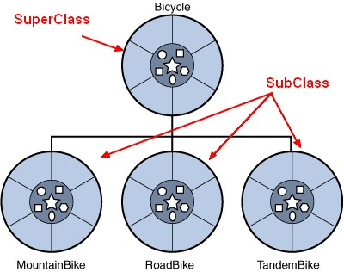
Inheritance
Inheritance allows a class to be a subclass of a superclass, and thereby inherit public and protected variables and methods of the superclass
All classes (except class Object), are subclasses of type Object, and therefore they inherit Object’s methods
The main advantage is the reuse of code in the subclass, modifying or adding something new
flue
Amnesia
Notes:
For mountain bike I’ve replaced a property
For Roadbike leaved as it is.
Tandem bike added new property, two seats

Slide 12
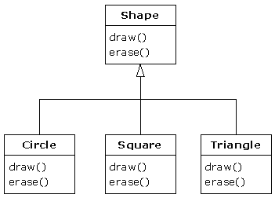
Polymorphism
The ability of an object to take on many forms
Polymorphism allows the same method to be implemented in different classes differently
Polymorphic method invocations apply only to overridden instance methods
flue
Amnesia
Notes:
I’m printer, I only have to call method draw(), and I don’t care how shape is drawn, I just have to print it.
Shape.draw()
In biology, polymorphism (from Greek: poly, meaning "many" and morph, meaning "form") is a genetic variation where two or more forms, or types exist in the same species.

Slide 13
Constructors and Instantiation
To make a new object, you have to invoke the constructor of the object’s actual class type and the constructor of each of its super classes
Every class, even an abstract class, has at least one constructor
Constructors must have the same name as the class
Constructors don’t have a return type
The compiler will create a default constructor if you don’t
Interfaces do not have constructors
flue
Amnesia

Slide 14
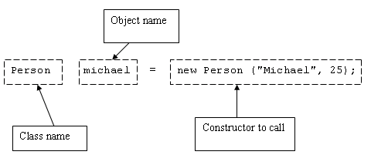
Instantiation
flue
Amnesia

Slide 15
Overridden Methods
A method from a class is considered to be overridden by a subclass’ method when they have the same signature
Overriding method must have the same argument list, same return type, must not have a more restrictive access modifier, must not throw new or broader checked exceptions, may throw fewer or narrower checked exceptions, or any unchecked exception
Abstract methods must be overridden by the first concrete (non-abstract) subclass
Final methods cannot be overridden
Only inherited methods may be overridden
flue
Amnesia

Slide 16
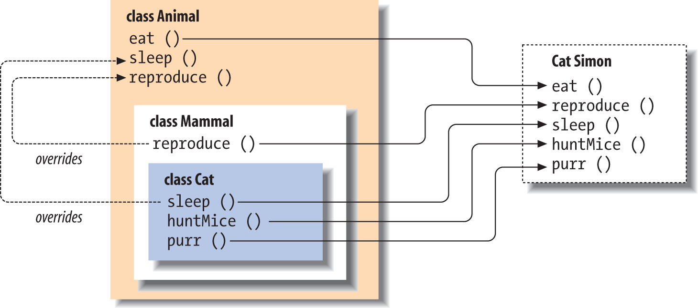
Overriding

Slide 17
Overloaded Methods
Method overloading is the ability to define multiple methods with the same name in a class
Overloaded methods
must have different argument lists;
may have different return types, if argument lists are also different;
may have different access modifier;
may throw different exceptions
flue
Amnesia

Slide 18
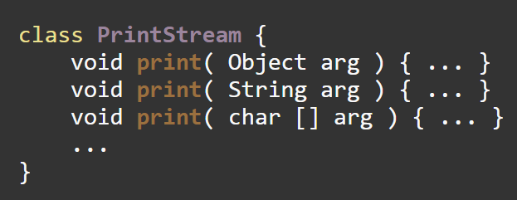
Overloading
flue
Amnesia
Notes:
Why do not use different name ? Because the method scope is the same, it prints something to stream

Slide 19
Class Access Modifiers
There are four access levels:
public,
protected,
*default
Private
Classes can have only public or default access
A class with default access can be seen only by classes within the same package
A class with public access can be seen by all classes from all packages
flue
Amnesia

Slide 20
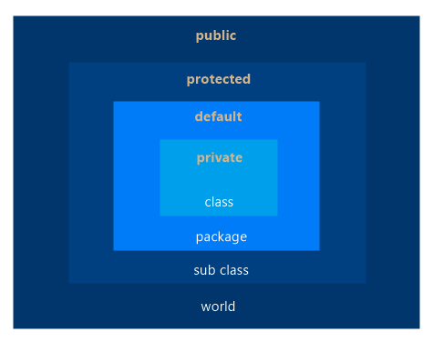
Access Modifiers
flue
Amnesia
Notes:
Draw circles on whiteboard with multiple class in it. Explain.

Slide 21
Class Modifiers (Nonaccess)
Classes can be modified with final, abstract or strictfp
A class cannot be both final and abstract
A final class cannot be subclassed
strictfp is a class keyword that restricts floating-point calculations to ensure portability.
flue
Amnesia
Notes:
A class cannot be both final and abstract, ask to audience why?
The strictfp keyword can be applied on methods, classes and interfaces.

Slide 22
Abstract Classes
Class containing at least one abstract method, must be declared abstract
Abstract class may contain static and instance variables
Abstract class my have constructors, static and instance methods
Abstract class may not have abstract methods
Abstract class can’t be instantiated
Abstract class is designed to be extended
Abstract class can have both abstract and nonabstract methods
The first concrete class to extend an abstract class must implement all of its abstract methods
Notes:
Difference between interface and abstract class. ?
Why do we need abst clases ?

Slide 23
Coupling and Cohesion
Coupling refers to the degree to which one class knows about or uses members of another class
Loose coupling is the desirable state of having classes that are well encapsulated, minimize references to each other and limit the breadth of API usage
Tight coupling is the undesirable state
Cohesion refers to the degree in which a class has a single, well-defined role or responsibility
High cohesion is the desirable state of a class whose members support a single, well-focused role or responsibility
Low cohesion is the undesirable state
Notes:
Coupling and Cohesion is more about design.
Low Cohesion => Class has methods: withdrawMoney(), ConnectToBD(), loginUser()

Slide 24
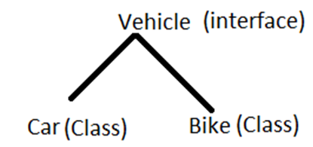
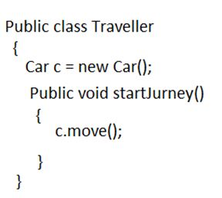
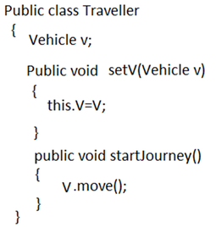
Coupling
Notes:
Tight-Coupling
Loose-Coupling
Hint : Do not use concrete classes, and class instantiation (new) - > Use interfaces/abstractclasses insteaded and set the concrete class via set()

Slide 25
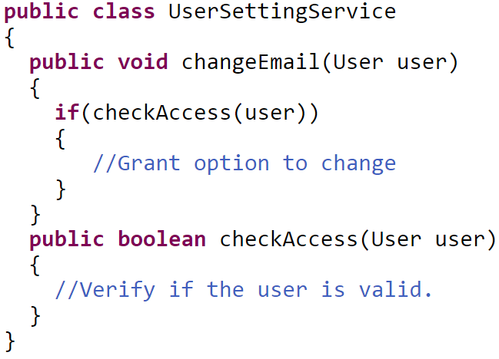
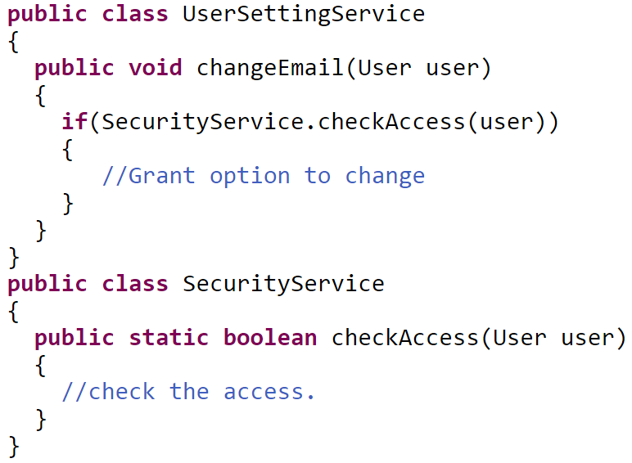
Cohesion
Notes:
Suppose you are asked to implement a UserSetting service where in the user can change the settings but before that the user has to be authenticated. One way to implement this would be:
All looks good, until you would want to reuse the checkAccess code at some other place OR you want to make changes to the way checkAccess is being done
move the checkAccess code into ints own SecurityService.

Slide 26
Summary
OOP fundamental principals are: inheritance, encapsulation, polymorphism
Inheritance allows inheriting members form another class
Encapsulation hide internal data and allow working through abstract interface
Polymorphism allows working with objects through their parent interface and invoke abstract actions
Four access modifiers: public, protected,*default, private
Strong cohesion and loose coupling avoid spaghetti code

Slide 27


Valentin Bragaru
Senior Developer
Valentin.bragaru@endava.com
en_vbragaru
Notes:
Break 5 min for a glass of water/coffe.
Next Java Classes and Interfaces.

